Slide 1
Mixed Traffic Simulation for Autonomous Systems in Shared Spaces
Student: Toby Hillier
CID: 01412520
Supervisors: Prof Y.K Demiris and Dr X. Zhang
Second Marker: Prof D.Gunduz

Slide 2
Purpose and Objectives
Survey the current state of the art in vehicle and mobile robot simulation and evaluate current simulators (e.g. CARLA, CrowdSim3D, Gazebo), list and understand the underlying simulation methodologies (e.g. types of physics engine), and understand and document their advantages and disadvantages, particularly in terms of their sensing and control abilities.
Select the most suitable current simulator that offers potential for incorporating mixed traffic (for example, cars, mobile robots/wheelchairs, humans, cyclists, and so on), and 3D environments/maps.
Create a process for incorporating and controlling agent models with an API (e.g. ability to add control abilities to the human model, for example to move their bodies, and to grasp objects).
Add sensors to the simulated agents (e.g. cameras, LIDARS) and a perception API, where simulation users can obtain sensing data from the simulator, for example what can the agents “see” in their environment.

Slide 3
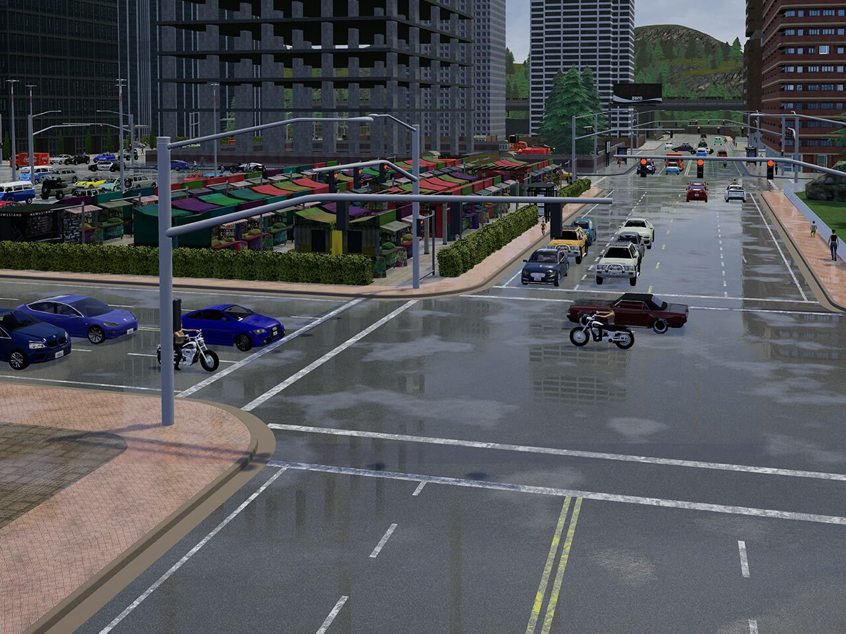
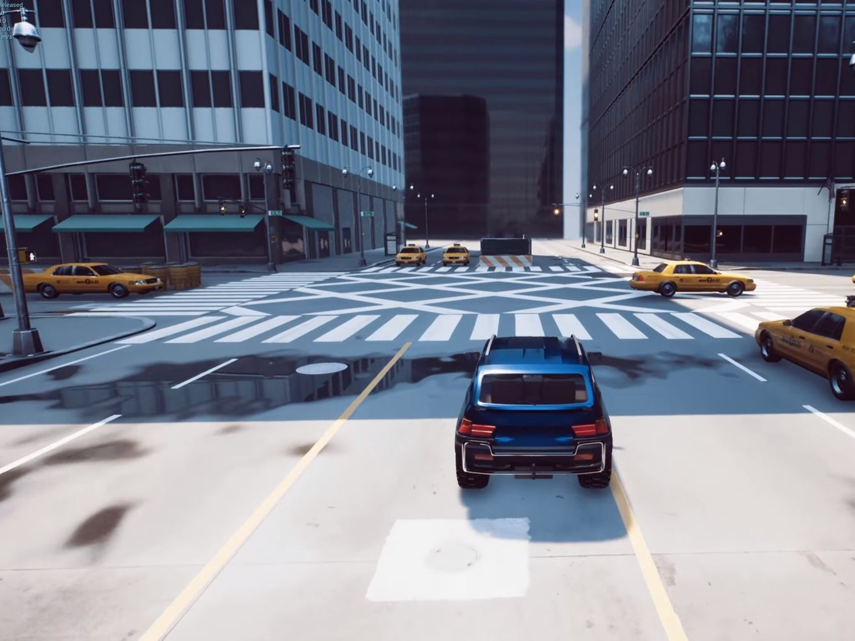
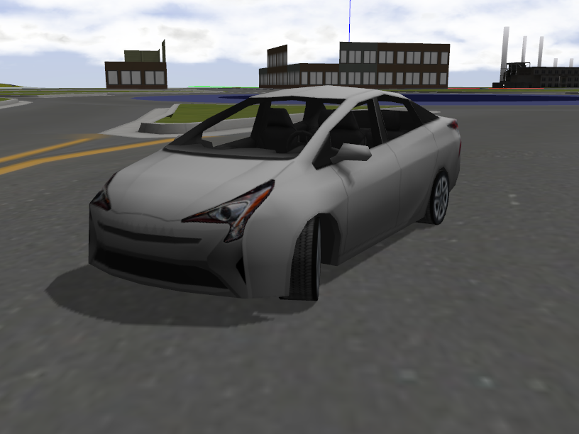
Analysis of Existing Simulators
Traffic Simulators
Vehicle Simulators
Robotics Simulators
Designed to simulate the interaction between different agents.
The vehicle behaviour is not very important.
(Carla, CrowdSim3D)
Designed to mimic the sensors and surroundings of a real vehicle.
Usually only one entity in the simulation.
(4DV-Sim, AirSim, Apollo, LGSVL Simulator)
Designed to accurately reflect the vehicle physics.
Uses physics libraries rather than a game engine.
(CoppeliaSim, Gazebo, Marilou, Webots)

Slide 4
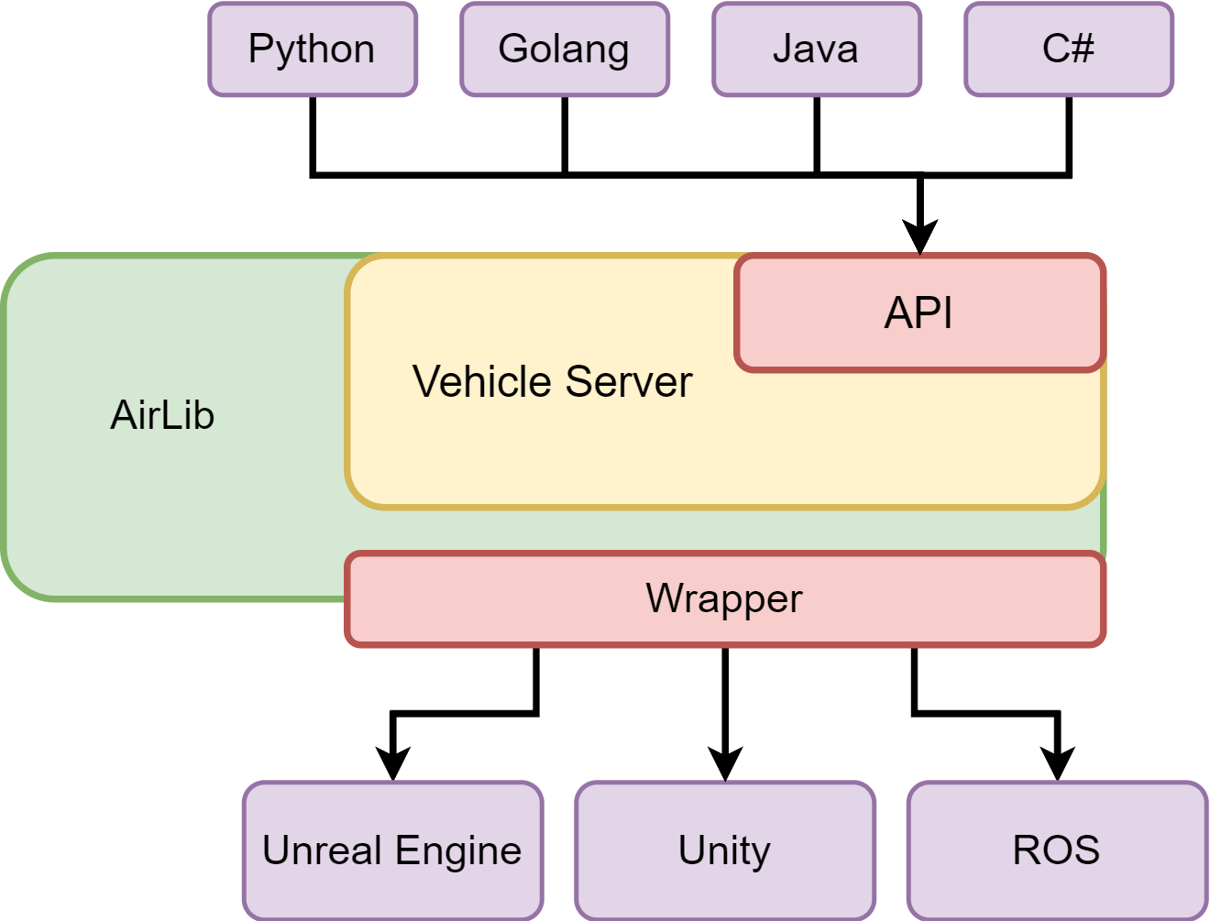
AirSim
Unreal Engine or Unity
Moving the logic to Unity
Dividing the server into three components
Redesigning the video feed

Slide 5
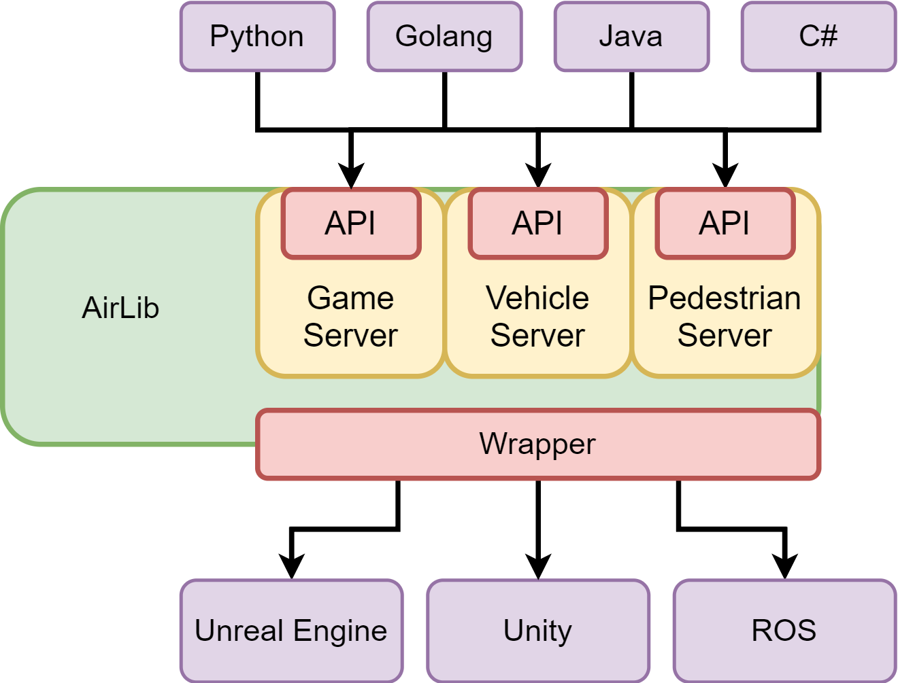
AirSim
Unreal Engine or Unity
Moving the logic to Unity
Dividing the server into three components
Redesigning the video feed

Slide 6
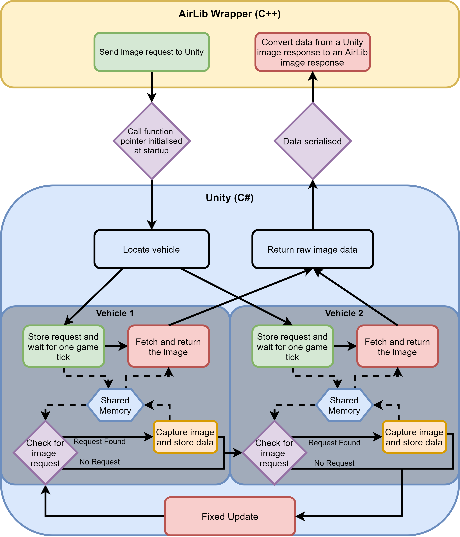
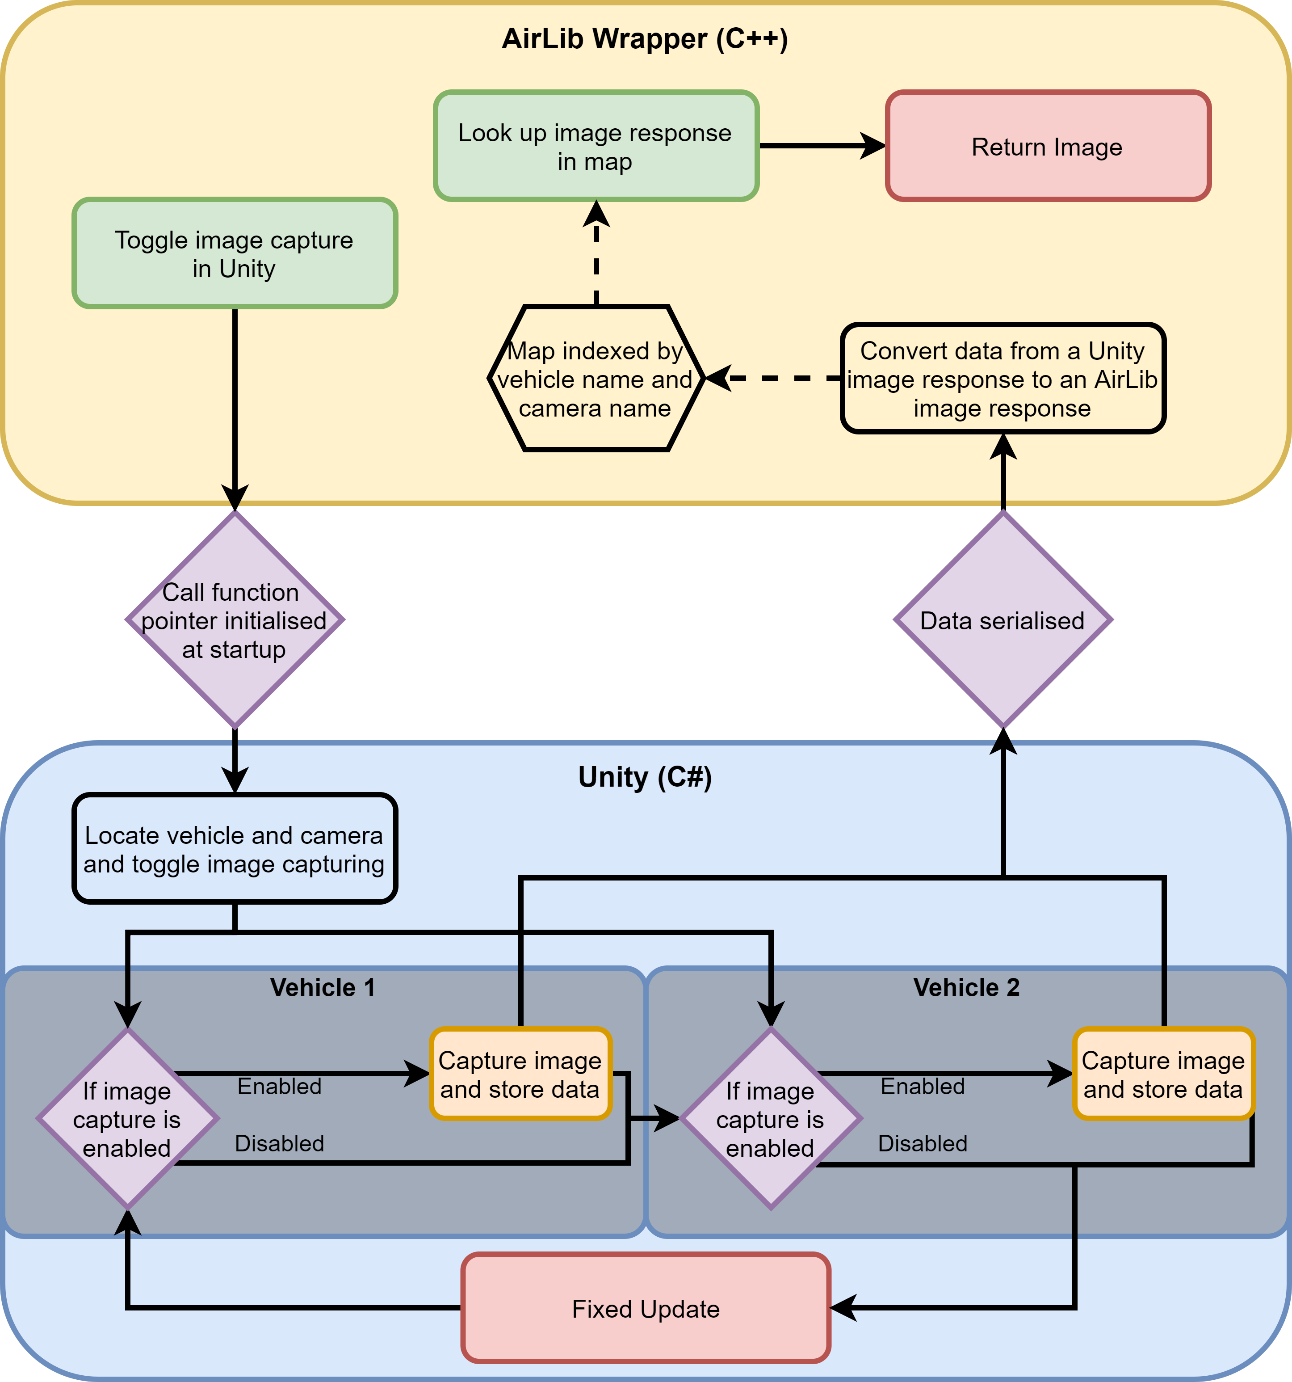
AirSim – Video Feed

Slide 7
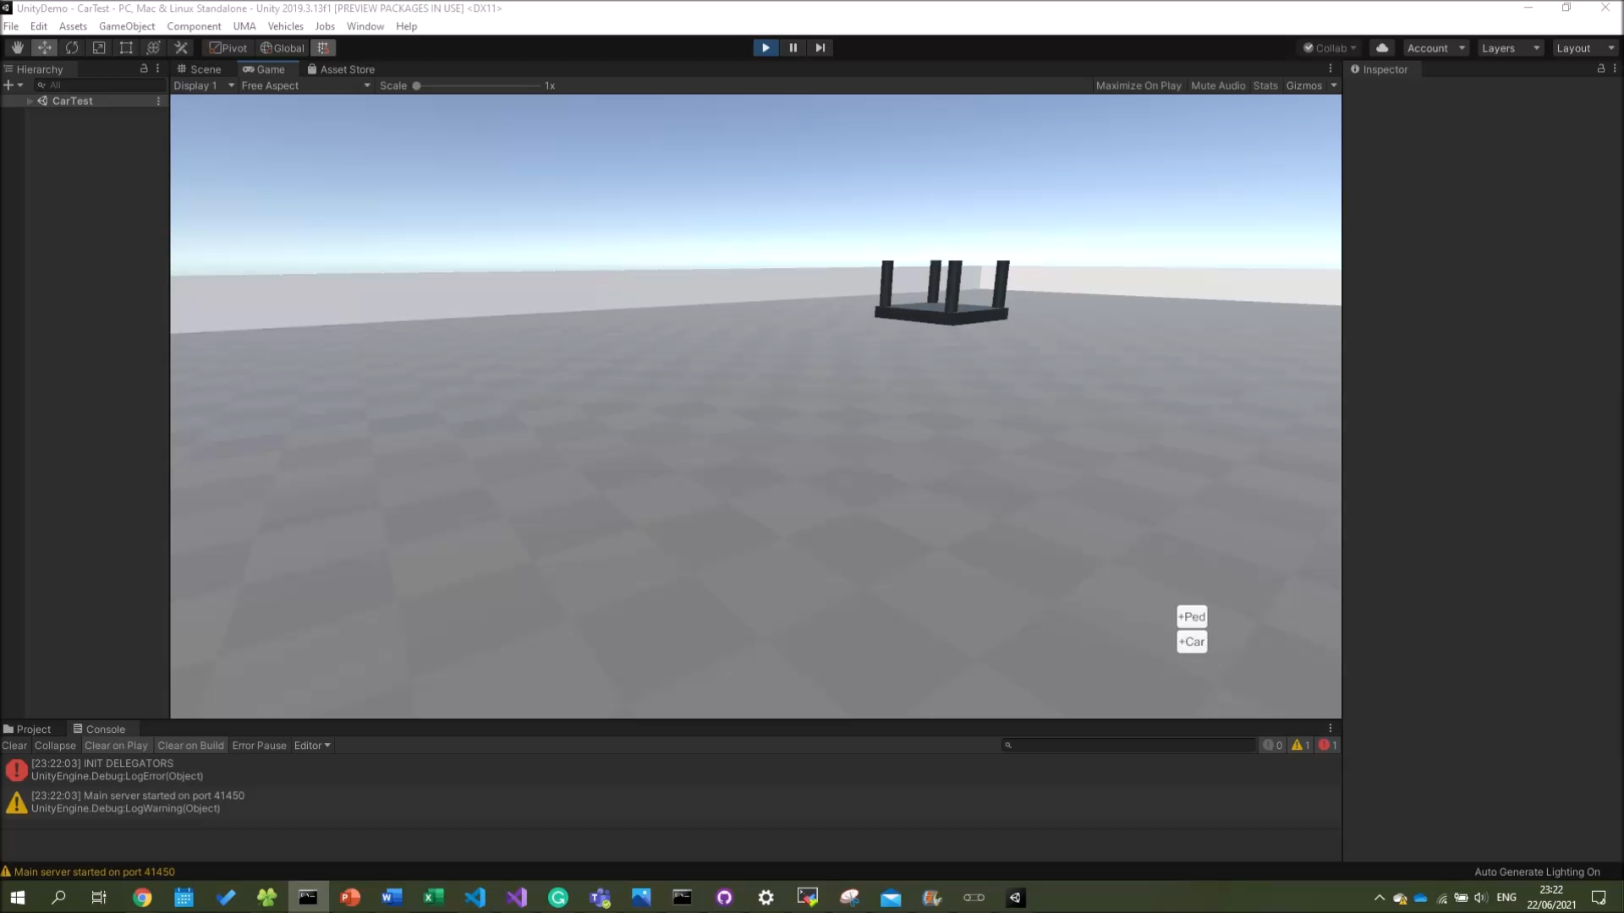
AirSim – Video Feed

Slide 8
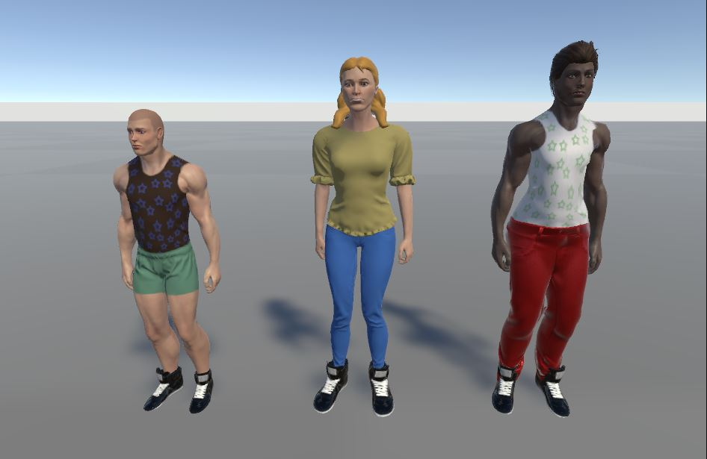
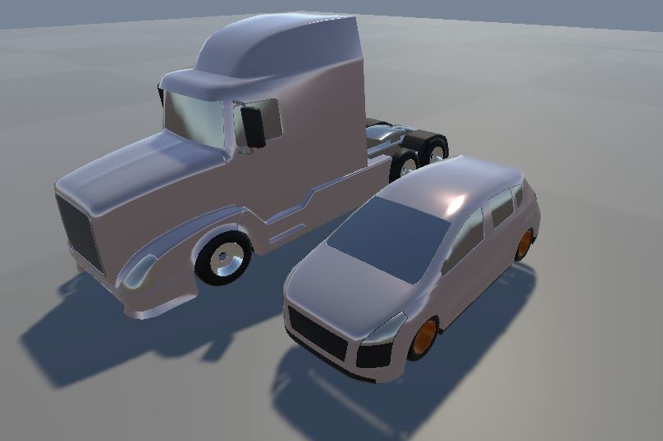
Extending AirSim
Spawning agents at runtime
Handle multiple agents
Add pedestrians
Add additional APIs
Camera movement

Slide 9
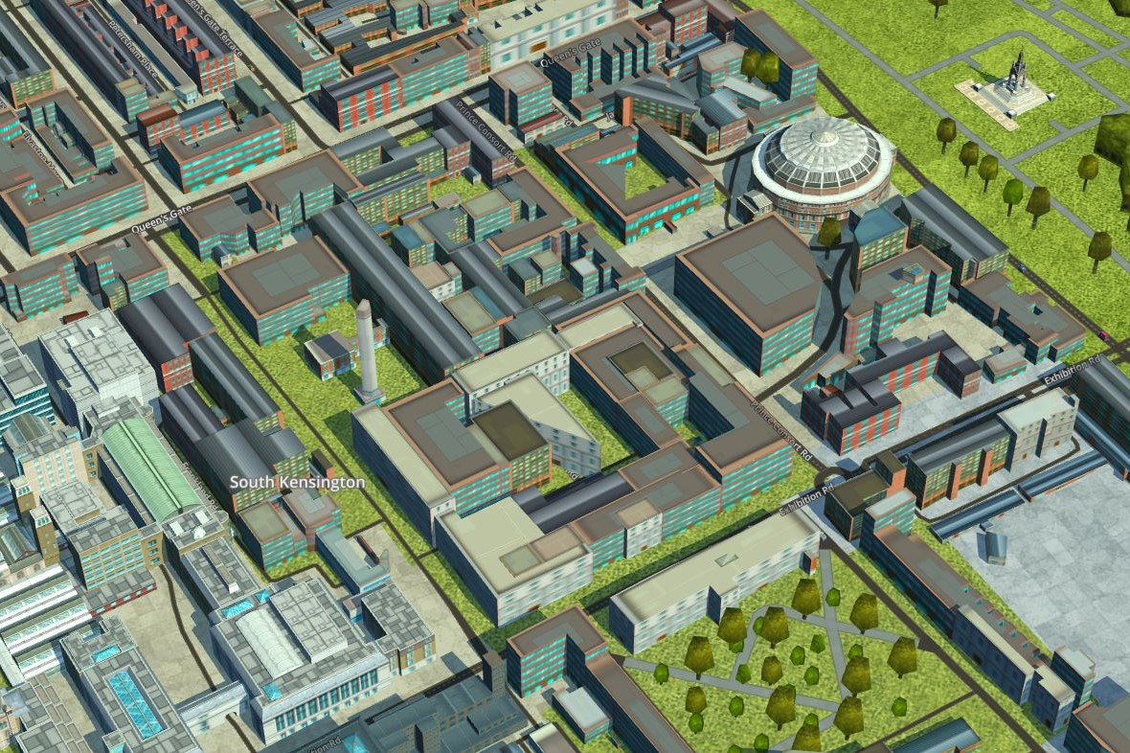
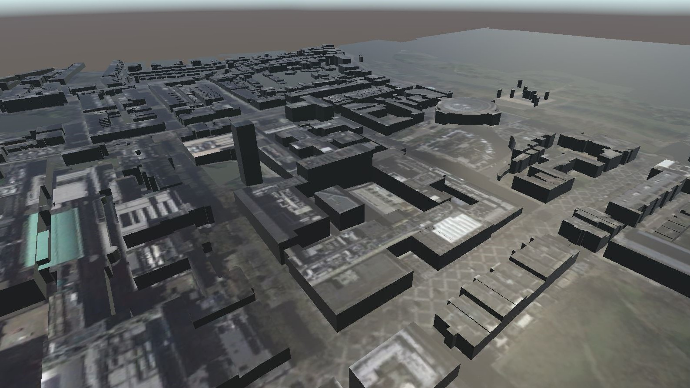
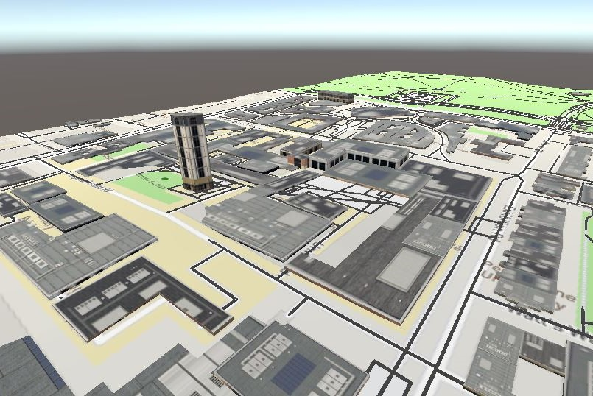
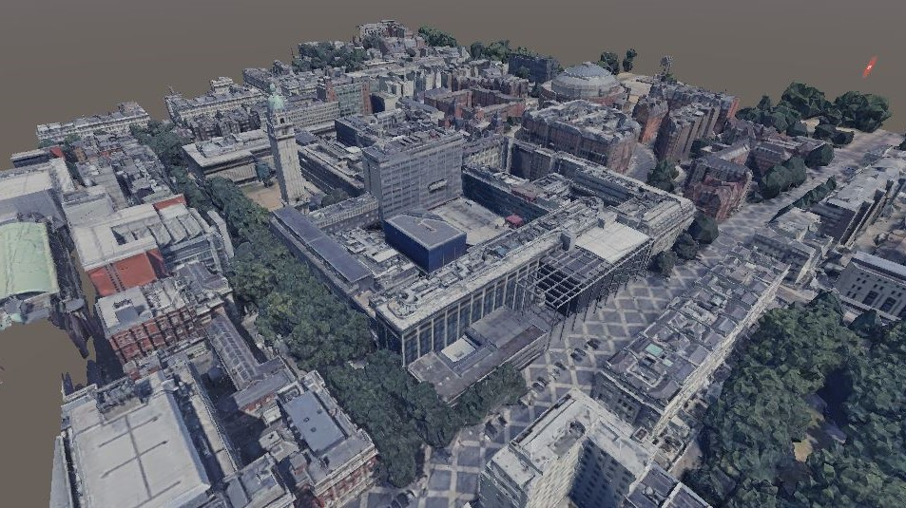
Environments and Maps
Unity Map SDKs
Unity Assets

Slide 10
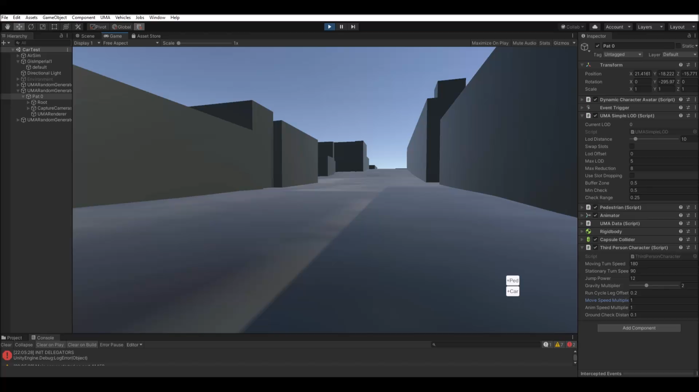
Extending AirSim

Slide 11
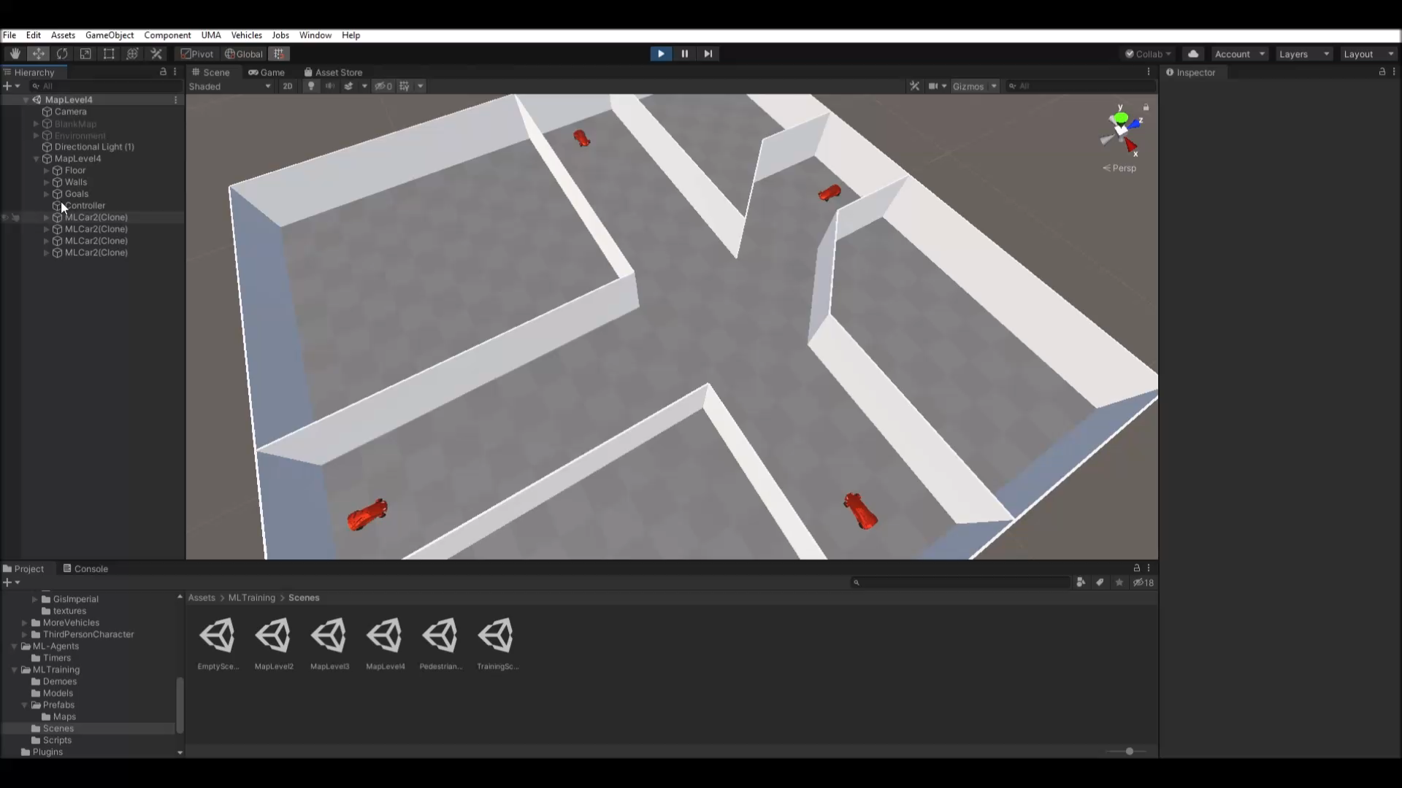
Unity ML-Agents

Slide 12
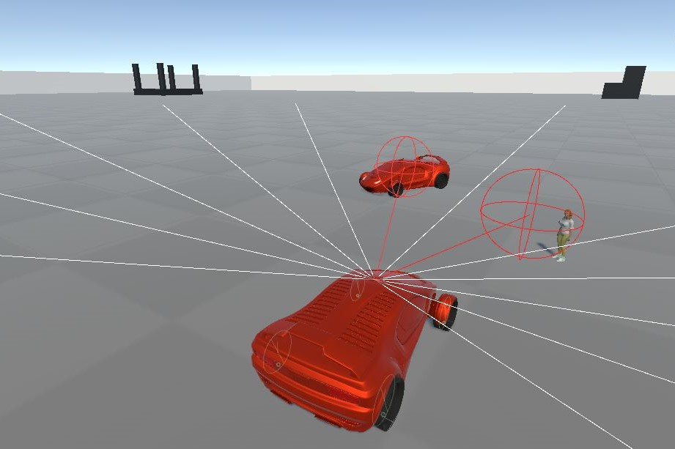
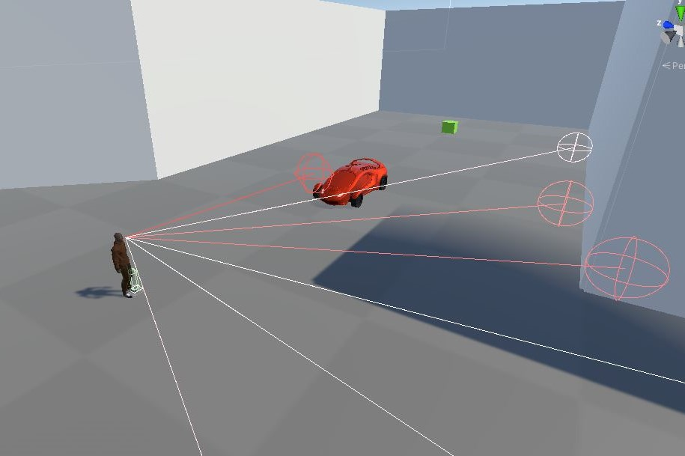
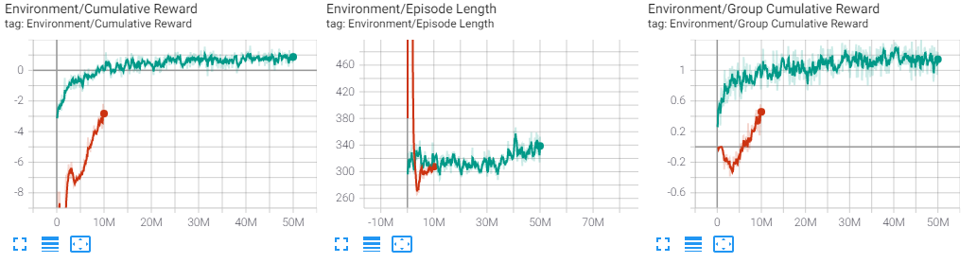
Unity ML-Agents
Number of input sensors
#Rays*(#Detectable tags + 2) = 11 * 4 = 44
1 speed input, 1 target direction
Continuous vs Discrete outputs
Imitation Learning – GAIL/BC
PPO and MA-POCA

Slide 13
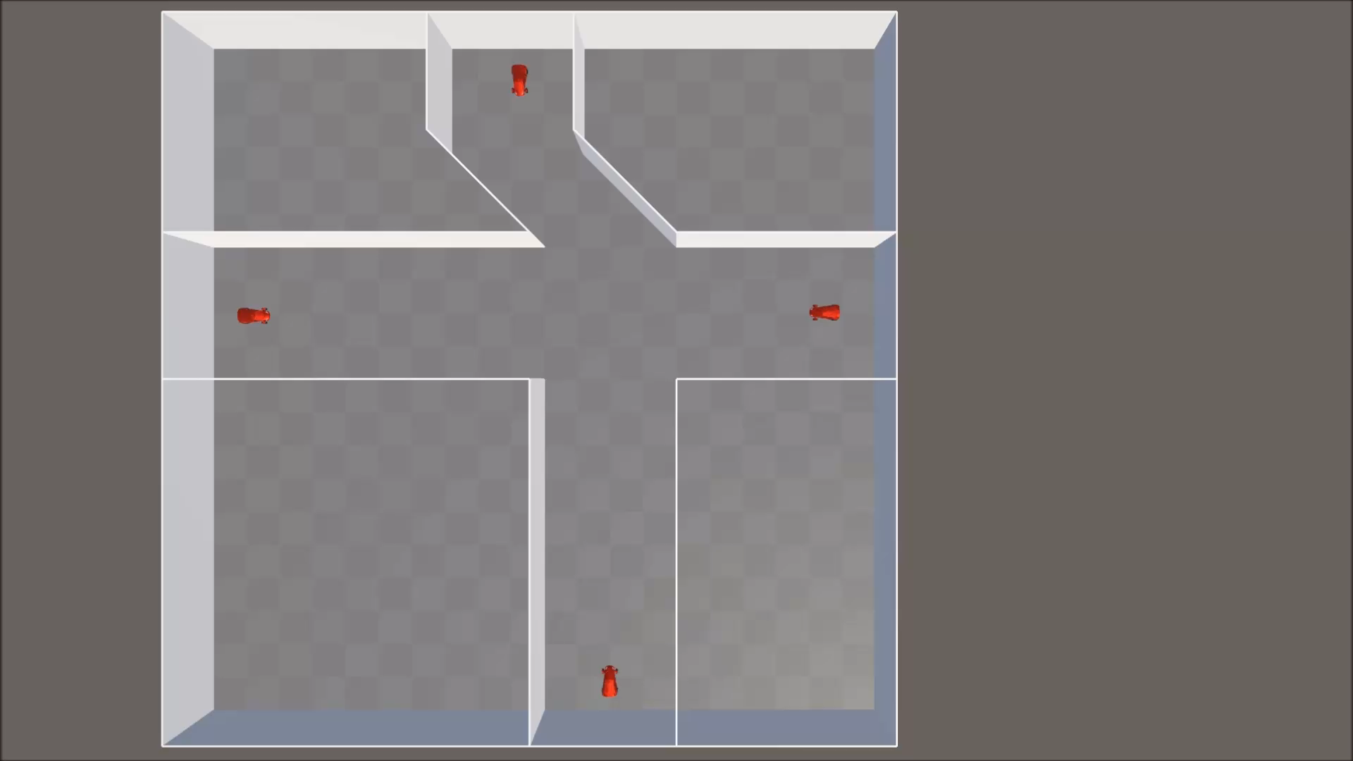

Slide 14
Conclusion and Further work
Conclusion
Allows for several different agents to be simulated in a shared environment.
Easy to extend the simulator by either adding additional vehicles or by adding a new entity with different APIs.
Further work
Extend the existing AirLib APIs to be in Unity.
Additional Control APIs.

Slide 15
Additional Slides

Slide 16
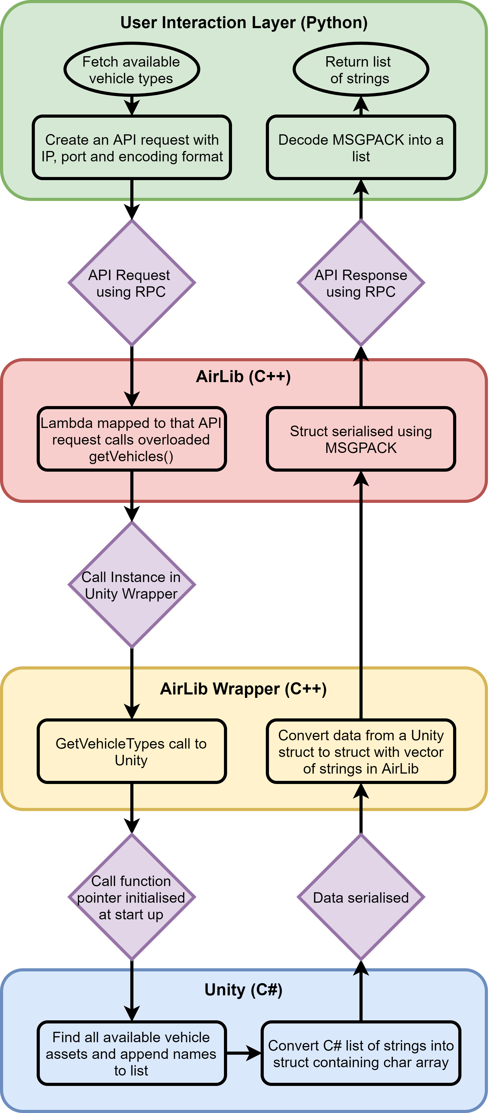
Flow chart of the API call which fetches a list of the available vehicle types

Slide 17
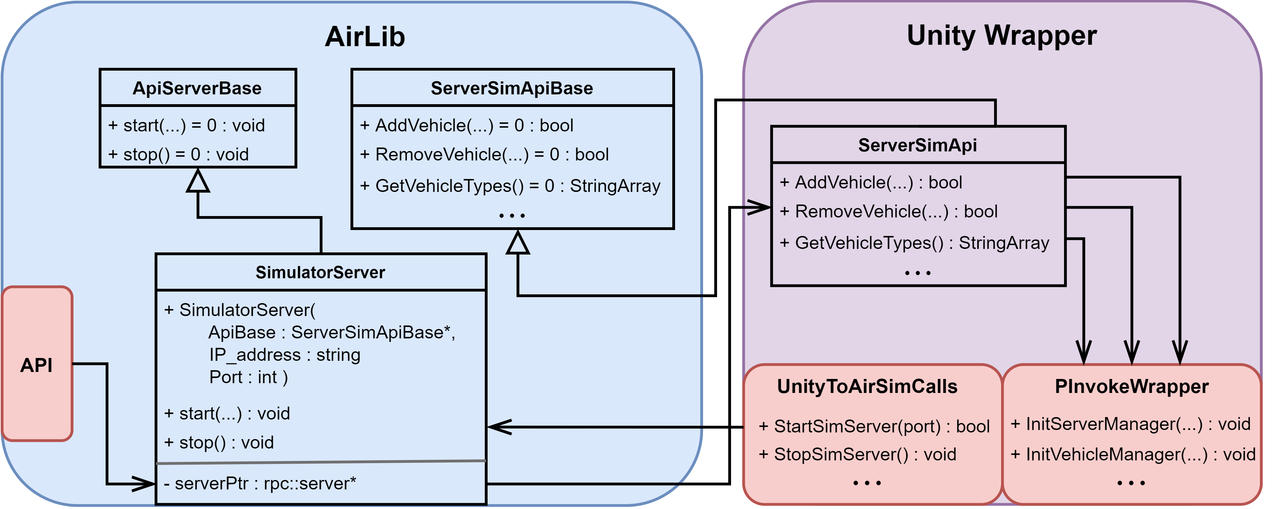
AirLib and Unity Wrapper

Slide 18
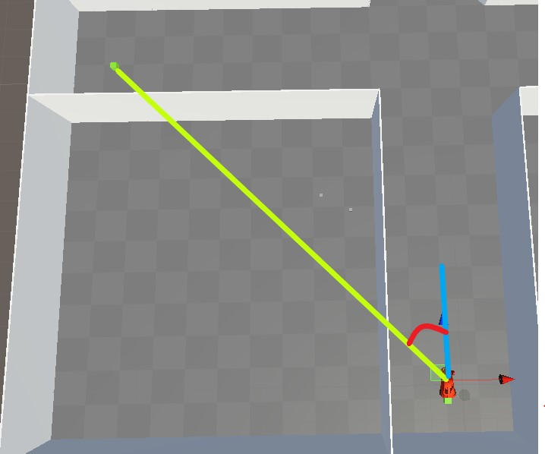
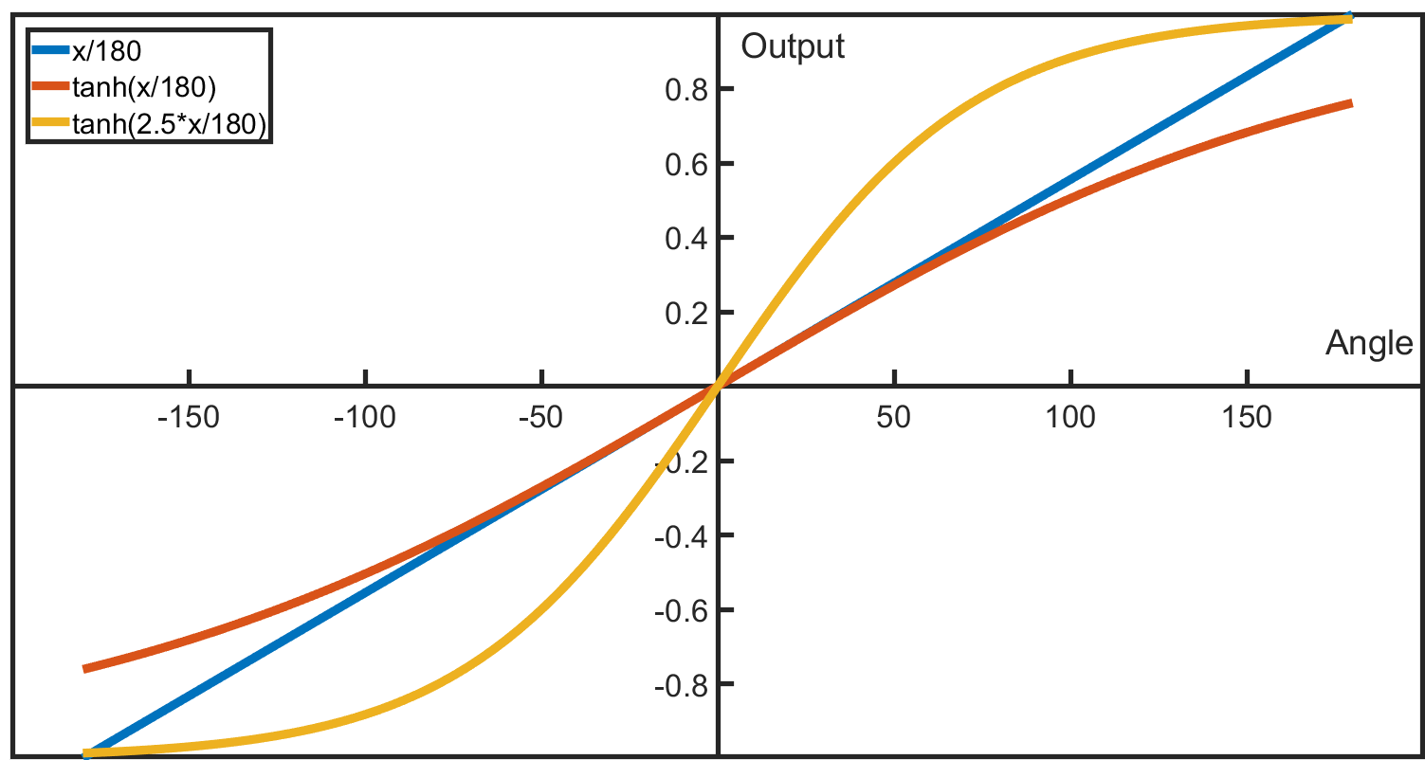
ML-Agents – Direction input

